Slide 1
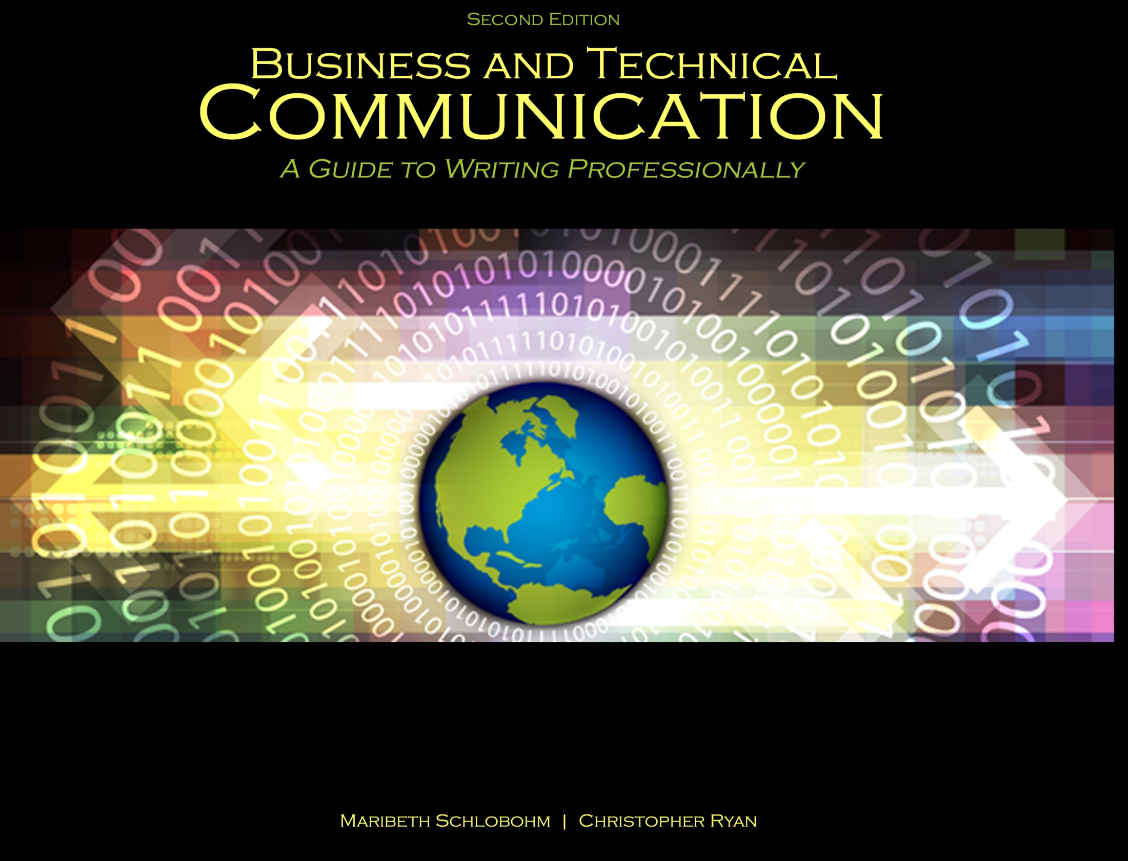
Chapter 1: Principles of Professional & Technical Communication

Slide 2

Defining Prof & Tech Communication
Applies style different from most academic writing: concise, easy to understand and digest
Research-oriented
Delivered with active voice (preferred); passive permissible when strategic
Considers audience
Designed for easy navigation
Works within limits of time and space
Applies etiquette

Slide 3
Tech Communication Structure
Introduction:
States purpose
Provides context
Forecasts what follows
Body:
Addresses topic(s) noted in introduction in greater detail
Provides supporting facts for arguments
Conclusion
Draws writing to close
Summarizes key points
Reminds audience of call to action

Slide 4

Editing Tech Communication
Grammar (common problem areas):
Subject-verb agreement
Articles
Commas, semi-colons, and colons
Sentence fragments, run-ons, and gerunds
Pronouns
Parallel structure

Slide 5

Ethics Defined
1. “Moral principles that govern a person’s behaviour [sic] or the conducting of an activity”
2. “The branch of knowledge that deals with moral principles”*
*Source: oxforddictionaries.com/english/ethics

Slide 6
Ethical Guidelines for Work
Know and do right
Give proper attribution
Respect intellectual property
Abide by employee agreements
Honor non-competition and non-disclosure agreements
Ensure safety and security

Slide 7
References
“Ethics,” oxforddictionaries.com/english/ethics. Feb, 2014. Web.
Schlobohm, Maribeth and Christopher Ryan. Business and Technical Communication: A Guide to Writing Professionally, 2nd Ed., Dubuque, IA: Kendall-Hunt, 2014. Print.
Shutterstock. “Man checking text on a document,” Image ID: 140887543; “Info-text-graphic-ethic,” Image ID: 145461094. Feb 2014. Web.

Slide 8
Contact Information
Kendall-Hunt Publishing Company
4050 Westmark Drive
Dubuque, IA 52004-1840
http://www.kendallhunt.com
Toll Free: 800-228-0810

